Slide 1
Bell Work
What do we need to review?

Slide 2
From last time…
Page 121 #1, 3, 7, 9, 10, 11, 19
Page 123 #3, 6

Slide 3
Pre-calc trig
Day 10

Slide 4
Objective
Review main concepts for Test
Quiz to check for understanding

Slide 5

Quiz 2: Level 2
$Given f\left(x\right)=5x−1 and g\left(x\right)=2x+$ 8
Simplify the following. State Domain and Range.
$1.) f\left(x\right)−g(x)$
$2.) \frac{f(x)}{g(x)}$
$$3.) f\left(x\right)∗g(x)$$

Slide 6
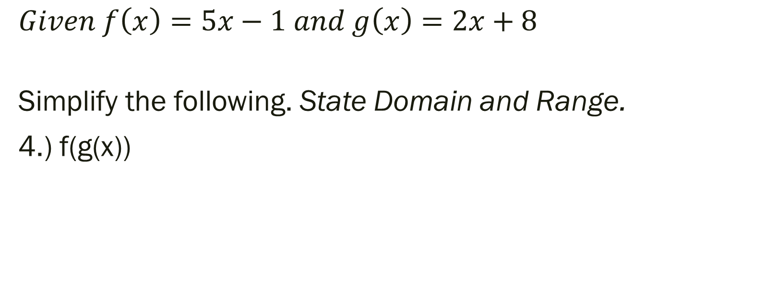
Quiz 2: Level 3
$Given f\left(x\right)=5x−1 and g\left(x\right)=2x+8$
Simplify the following. State Domain and Range.
4.) f(g(x))

Slide 7
Quiz 2: Level 4
5.) Given the tables above evaluate the following:
f(g(2)) = ___________ g(f(2)) = ___________
x | 2 | 5 | 9 | 11
f(x) | 7 | 16 | 28 | 34
x | -2 | 1 | 2 | 7
g(x) | -1 | 7 | 9 | 26

Slide 8
Finish Homework and Prepare for Test
Optional Review Assignment:
Page 49 #41, 43, 53, 55
Page 50 #71 – 82, 91
Page 88 #9 – 11, 37 – 43
Evaluate using Unit Circle
Understand Domain and Range of sin and cos

